Slide 1
G.Swapna
Lecturer in Botany
Gymnosperms

Slide 2
Seed Plants
Reproduce by seeds
Seeds develop from fertilized egg cell
2 Groups of Seed Plants:
Gymnosperms
Angiosperms

Slide 3
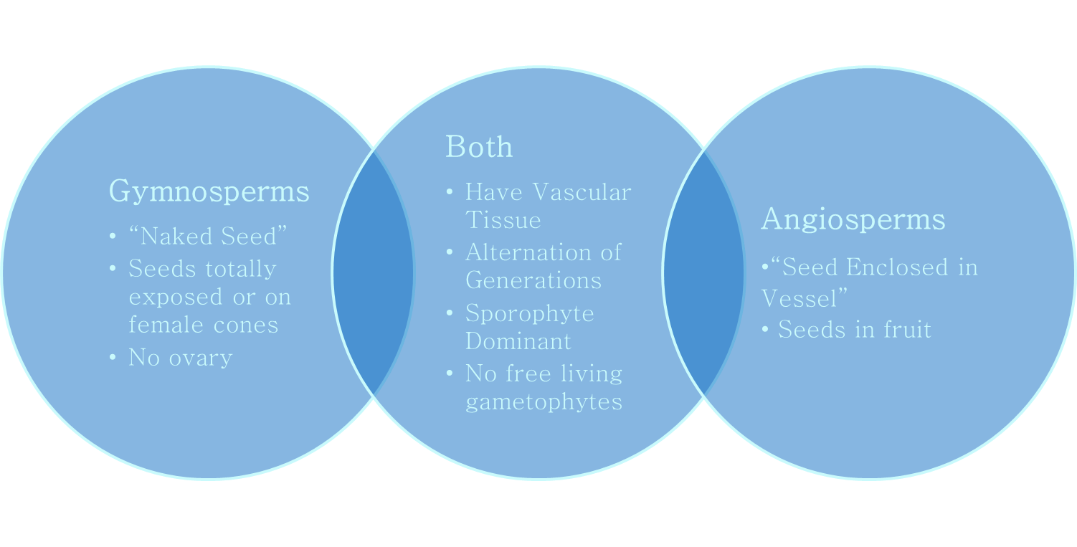
Gymnosperms & Angiosperms
Seed plants are categorized in 2 groups based on whether ovary wall surrounds ovules

Slide 4
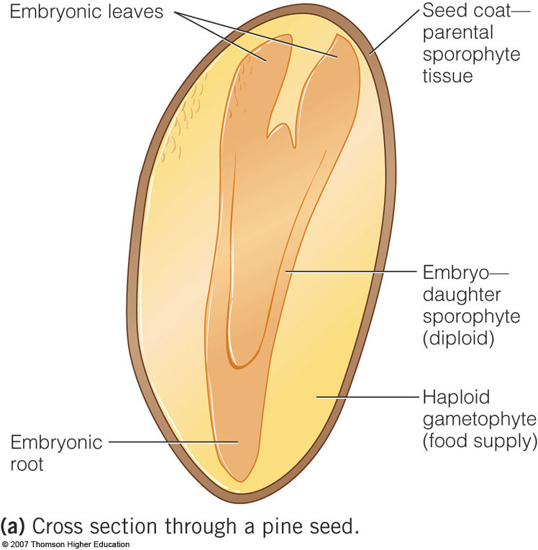
3 Parts of a Seed
Embryonic Plant (roots, stem, leaves)
Nutritive Tissue (Haploid n food reserves)
Protective Coat

Slide 5
Seeds are Reproductively Superior to Spores
Seeds
Spores
Multicellular
Well developed young plant inside with
Roots
Stem
Leaves
Food Supply
Seed coat protects seed
Unicellular
Unprotected
Small food reserves

Slide 6
Seed Plant Reproduction
All seed plants are heterosporous
Produce 2 types of spores
Microspores – spores grow into male gametophyte
Male gametophyte = pollen grain (4 cells big)
Megaspores – spores grow into female gametophyte

Slide 7
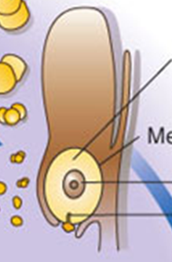
Lady Structures
Ovule – structure in seed plants that develops into seed after fertilization
Integuments – outer layer of an ovule that develops into a seed coat after fertilization
Has a micropyle – tiny opening
where pollen tube enters

Slide 8
Seed Plants also Produce Spores
Gametophyte Generation:
Microscopic structures in cones
Pollination: transfer of pollen from male cone to ovule in female cones.
Male cones produce thousands of pollen grains (immature male gametophyte)
Pollen is carried by wind to female cones
Pollen grains adhere to sticky droplets produced by female cones
Why so many pollen grains?

Slide 9
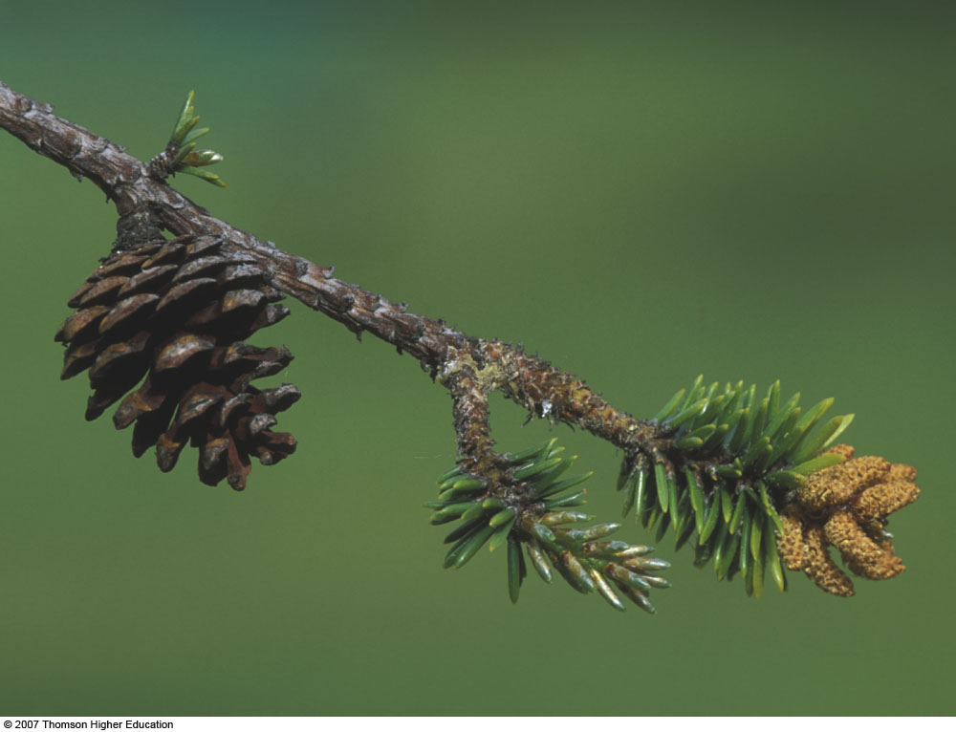
Male and Female Cones
Click Me!
Notes:
‹#›
2nd Hour Left off Here
4th Hour Left off Here

Slide 10
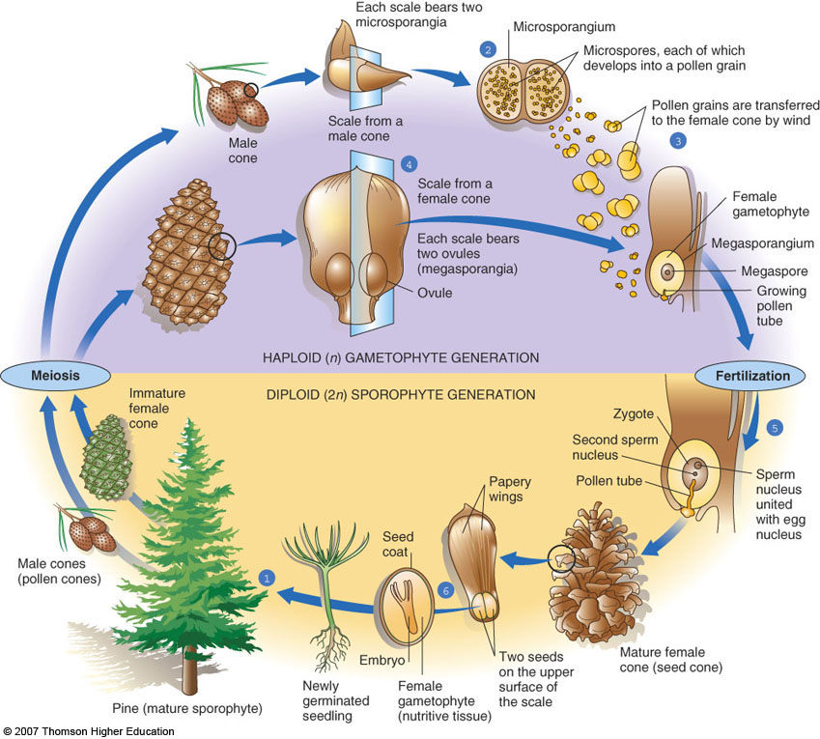
Life Cycle: Pine
Pollen/Spores
(haploid n)
Seeds
(diploid 2n)
Notes:
‹#›

Slide 11
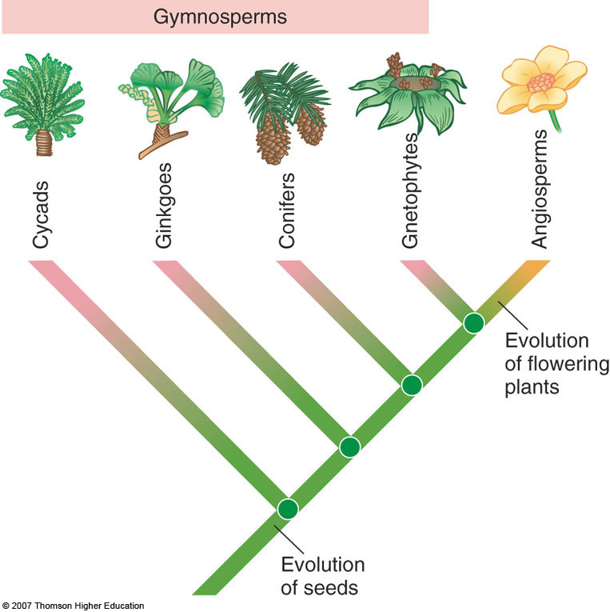
4 Groups of Gymnosperms
Conifers
Cycads
Ginkgo
Gnetophytes
Notes:
6th Hour Left off Here
‹#›

Slide 12
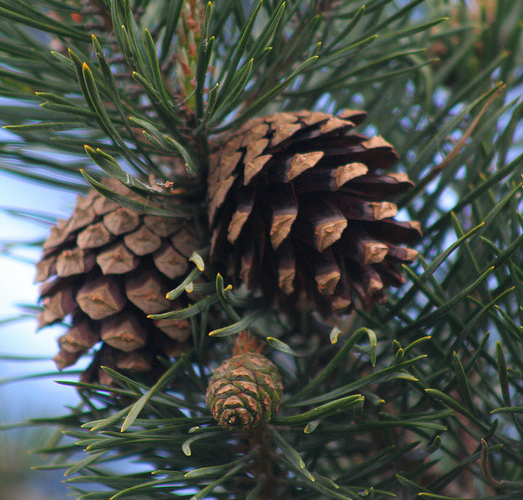
Conifers
Phylum Coniferophyta
Secondary tissues produced annually
None herbaceous
Produce resin – viscous clear substance with organic compounds that protect from fungal/insect attacks
Most have needles – (megaphylls)
Long, narrow, tough, leathery
Notes:
6th Hour left off here. 11/21/13
‹#›

Slide 13
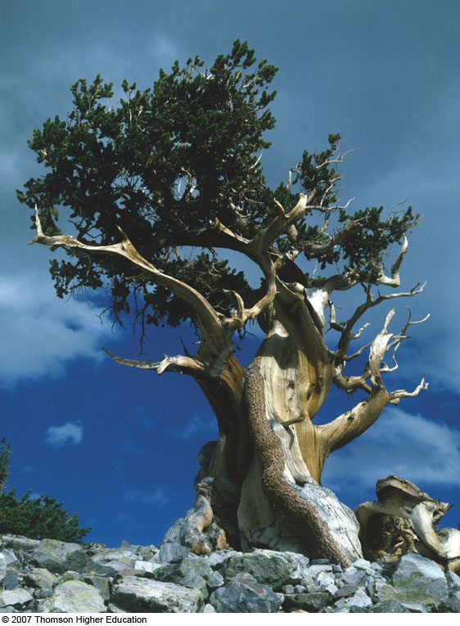
Conifers
Evergreen – bears leaves throughout the year
Thick, waxy cuticles with stomata
Water-conserving
Enable to retain leaves year round
Deciduous- few conifers shed needles at end of growing season
Monoecious – have male and female parts in same plant
separate cones on same plant
Ex: Pines, hemlocks, spruces, firs

Slide 14
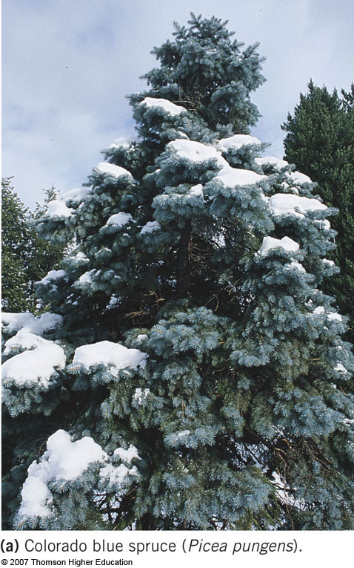
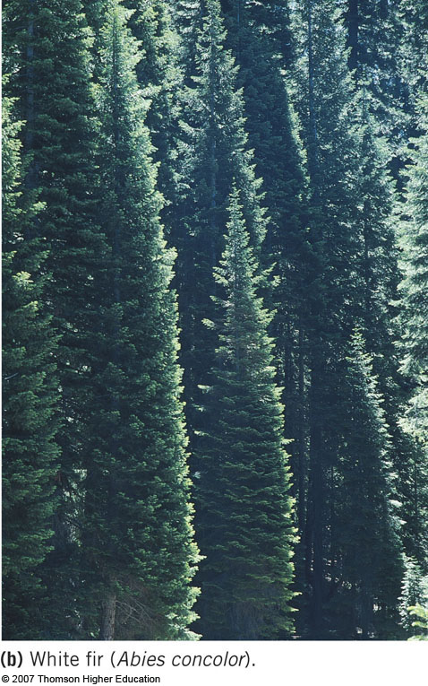
Conifers
Notes:
‹#›

Slide 15
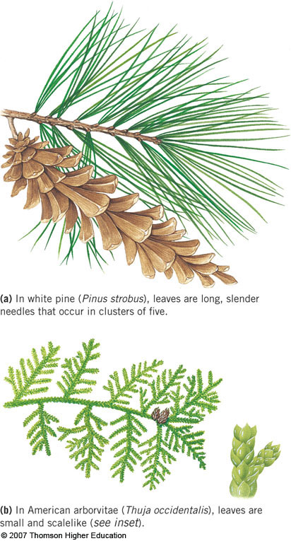
Conifer Leaves
Notes:
‹#›
1St Hour Left off Here

Slide 16
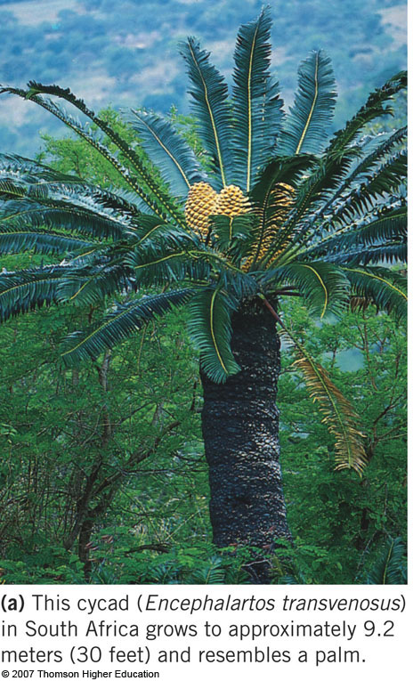
Cycads
Phylum Cycadophyta
Most now extinct
Tropical/subtropical
Dioecious- male and female reproductive parts on separate plants
Motile sperm cells
Transferred as pollen grain then swim up pollen tube
Many endangered
Palm/fern-like appearance

Slide 17
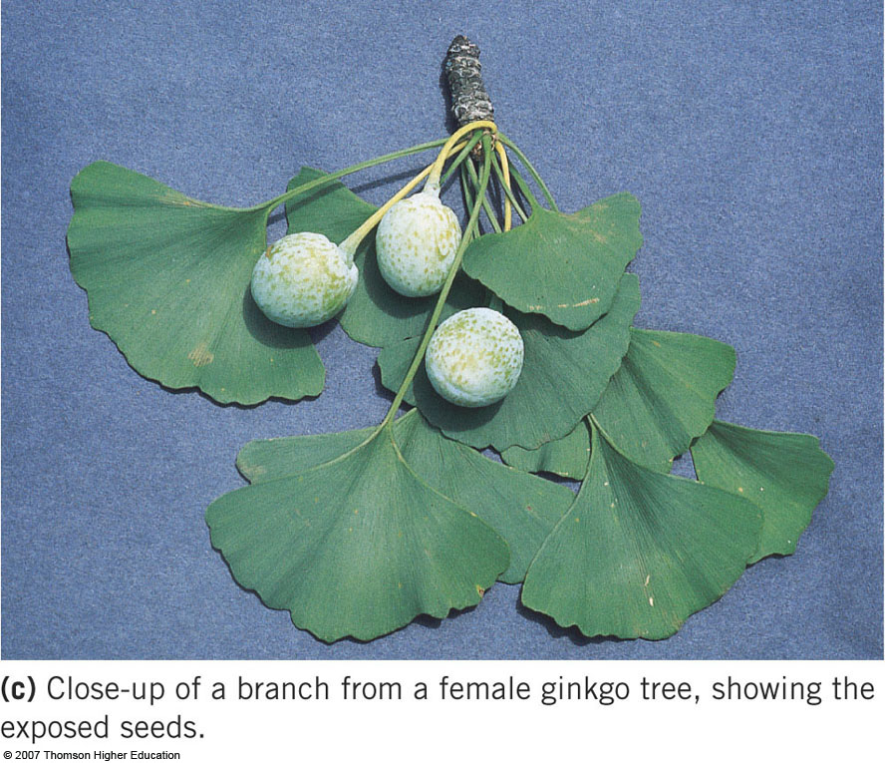
Ginkgos
Phylum Ginkgophyta
Only 1 Species
Oldest species of living trees
In China, ginkgo leaves and wood found 170 myo
Cultivated for edible seeds
Somewhat resistant to air pollution and disease

Slide 18
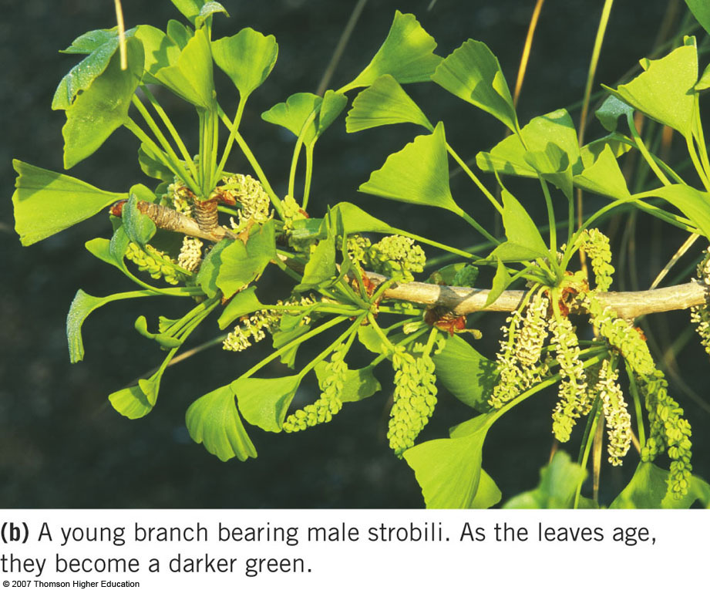
Ginkgos
Dioecious
Seeds exposed
Fleshy covering on seeds gives off foul odor
Extract from leaves used to increase neurological functioning
Studies may prove enhanced memory in elderly

Slide 19
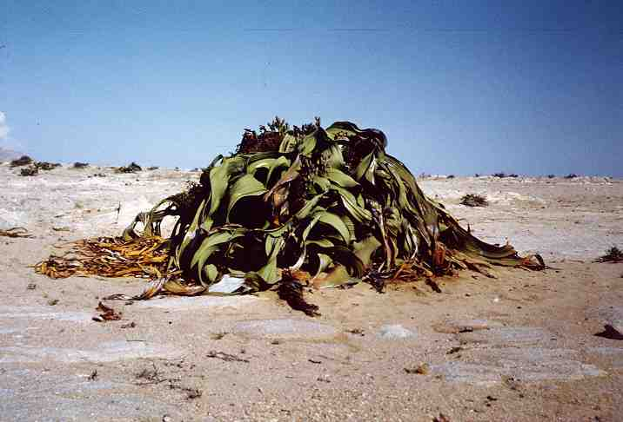
Gnetophytes
Phylum Gnetophyta
3 Distinct Genera:
Gnetum
Ephedra
Welwitschia
Most Dioecious
More advance than other gymnosperms
Efficient water conducting cells (vessel elements)
Have cone cluster that resemble flower clusters
Parts of life cycle resembles that of flowering plants

Slide 20
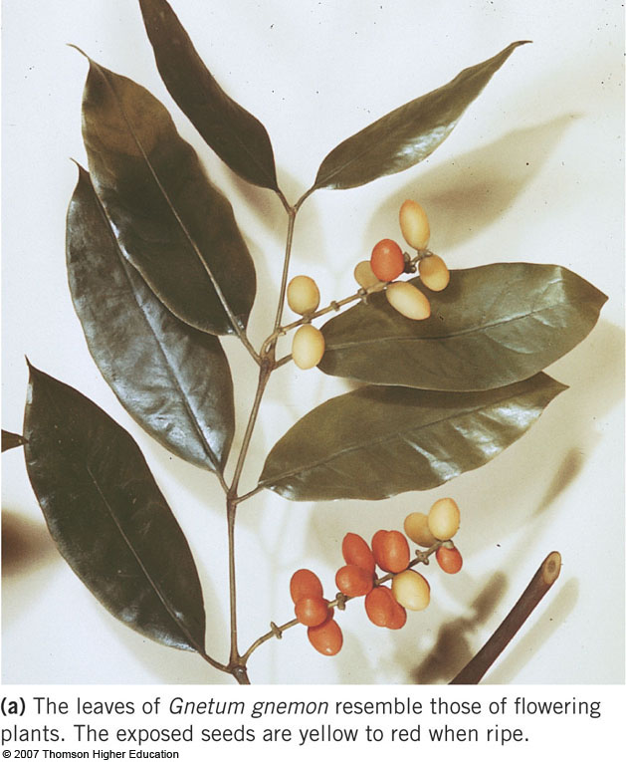
Gnetum
Tropical Vines, shrubs, trees
Simple broad leaves
Opposite arrangement on stem
Seeds
Fleshy, bright, outer covering
Resembles fruit

Slide 21
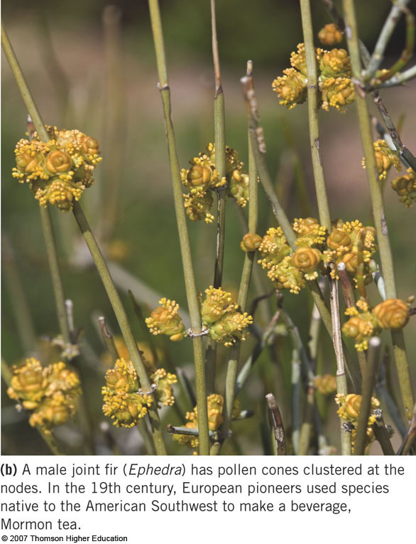
Ephedra
Shrubs & vines
Deserts, dry temperate, and tropical areas
One species is the source of ephedrine (simulates heart and raises blood pressure)

Slide 22
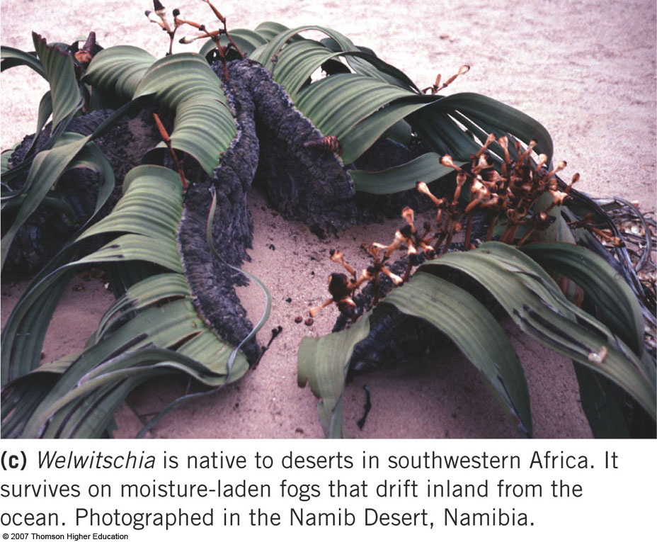
Welwitschia
1 Species
Long, underground taproot
Short, wide stem
Forms shallow disc from which two long ribbon-like leaves extend
Leaves grow throughout life
Reproduce by cones at ends of leaves
Notes:
2nd Hour Left off here
‹#›

Slide 23
Which is not a gymnosperm?
Spruce
Cycad
Maple
Gingko
Welwitschia

Slide 24

Ecology
Conifers are the predominant trees in about 35% of the world’s forests
Their roots hold soil in place, reducing soil erosion
Conifer forests are important watersheds and provide habitat for many organisms
Notes:
‹#›
4th Hour left off here

Slide 25

Economy
Recreational uses of forests
Camping, backpacking, picnicking, observing nature
Products
Lumber, medicinal products, turpentine, resins
Conifers grown commercially
Most economically important gymnosperms
Landscape design, Christmas trees
Notes:
‹#›

Slide 26
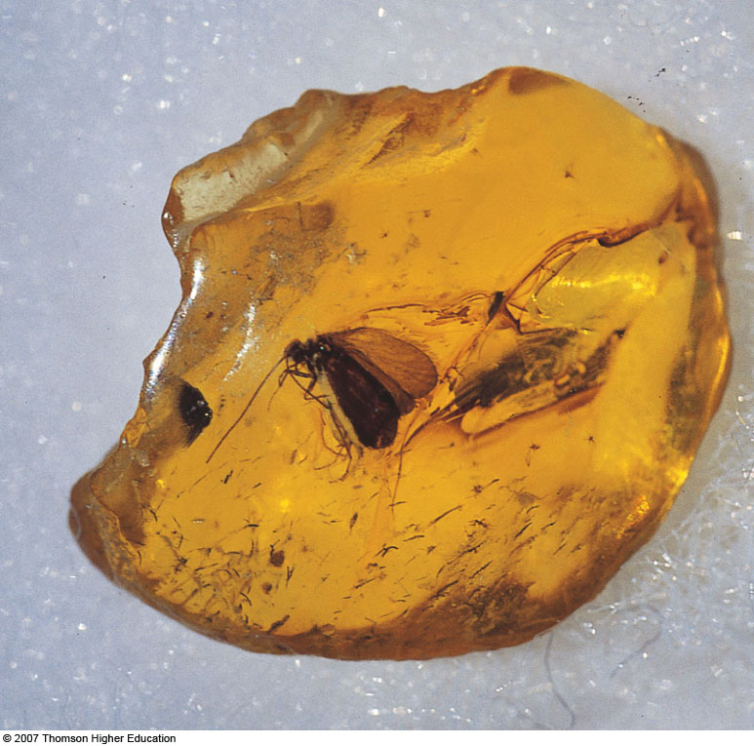
Amber
Notes:
‹#›

Slide 27
Thank You

