Slide 1
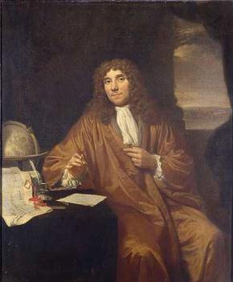
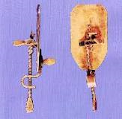
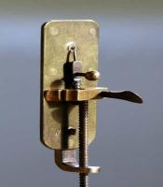
Antony van Leeuwenhoek (1632-1723) The Father of Microbiology
He constructed many Microscopes containing a single lens and magnified about 200 times. Who first accurately described the different shapes of bacteria

Slide 2
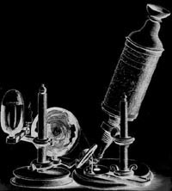
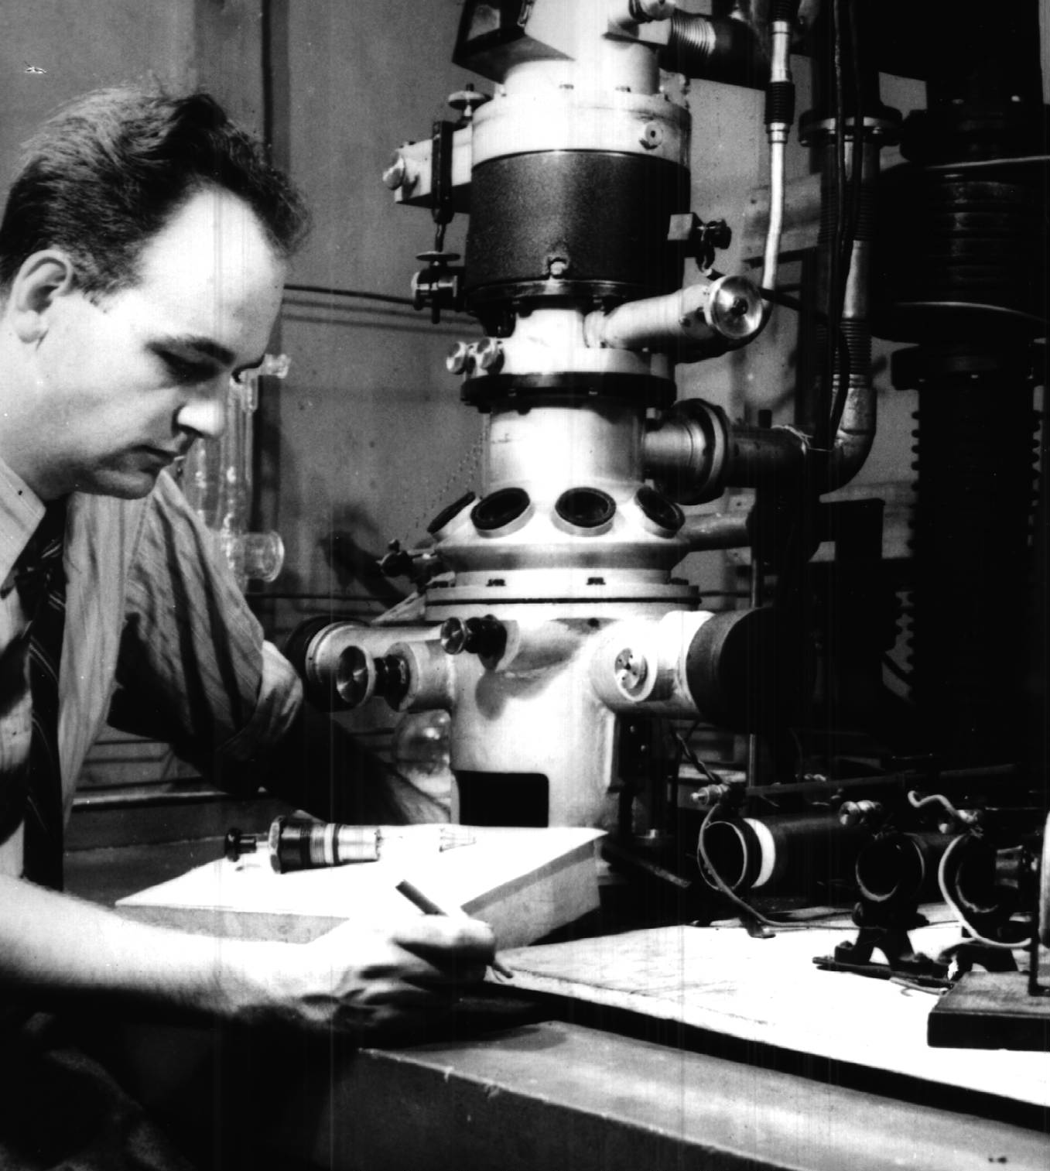
Hans and Zacharias Jansen
Ernst Ruska

Slide 3
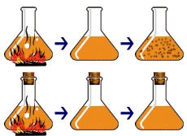

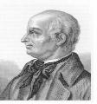
The Controversy Over Spontaneous Generation
John Needham & Lazzaro Spallanzani
Insufficient heating which failed to kill heat resistant forms of bacteria(Endospores)

Slide 4
Francesco Redi / Opposed SG
Redi's Problem
Where do maggots come from? Do they form by Spontaneous Generation
Hypothesis: Maggots come from flies.
Redi put meat into three separate jars.
Jar 1 was left open Jar 2 was covered with netting
Jar 3 was sealed from the outside

Slide 5
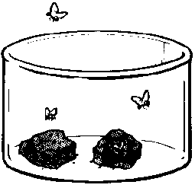
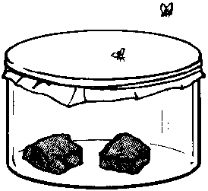
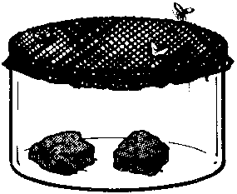
Francesco Redi / Opposed SG
Jar-1
Left open Maggots developed
Flies were observed laying eggs on the meat in the open jar
Jar-2
Covered with netting Maggots appeared on the netting
Flies were observed laying eggs on the netting
Jar-3
Sealed No maggots developed

Slide 6
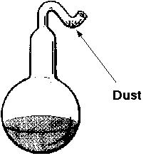
Louis Pasteur / Opposed SG
Pasteur's Problem
Where do the microbes come from to cause broth to decay. Hypothesis: Microbes come from cells of organisms on dust particles in the air; not the air itself.
Pasteur put broth into several special S-shaped flasks
Each flask was boiled and placed at various locations

Slide 7
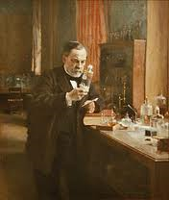
Louis Pasteur (1822-1895)
He is rightly called as founder of Microbiology.
In 1860-61, he disproved strong evidence to disapprove the theory of spontaneous generation.
In 1860-64, he gave experimental evidence that fermentation and putrefaction are effects of microbial growth
In 1863-65 he developed the process known as pasteurization
In 1865, Pasteur successes in demonstrating that silk worm disease was caused by protozoa.
In1880, he proved the chicken cholera and developed vaccine. He also developed Anthrax vaccine (1881)and rabies vaccine(1885).
Pasteur died in Paris on September 28,1895.His body lies in Pasteur Institute of Paris

Slide 8
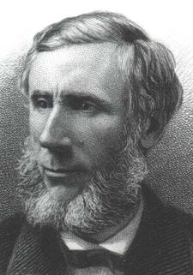
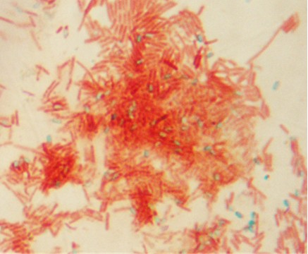
The Germ Theory of Disease
John Tyndall
Discovered that some bacteria existed in two forms:
1. heat-stable form (endospore)
2. heat-sensitive form (vegetative cell)
Need prolonged or intermittent heating to destroy the heat-stable endospores
His research resulted in a method of sterilizing liquid by heating it to boiling point on successive days, referred to as Tyndallization.
Tyndallization is useful for sterilization of growth media in science classes and other situations where autoclaves not available for pressure sterilization.

Slide 9
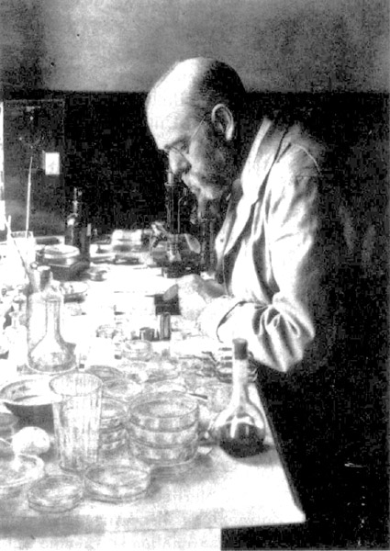
Although the microscope was invented in the 1600’s, it took 200 years for scientists to discover its use in isolating and identifying specific microbes for a particular disease.
1 in 7 People Died from TB
Robert Koch (1843-1910)

Slide 10
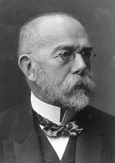
ROBERT KOCH
Credited with demonstrating the first direct link between a single microbe and a single disease – Tuberculosis.
1 in 7 People Died from TB

Slide 11
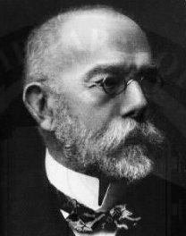
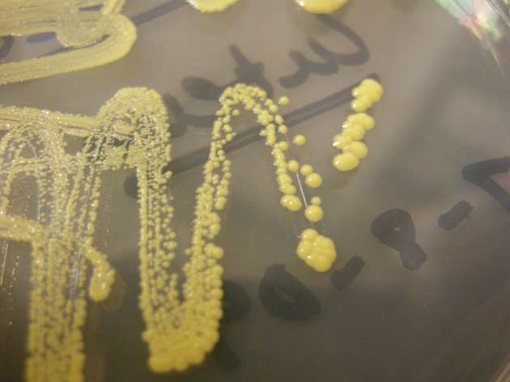
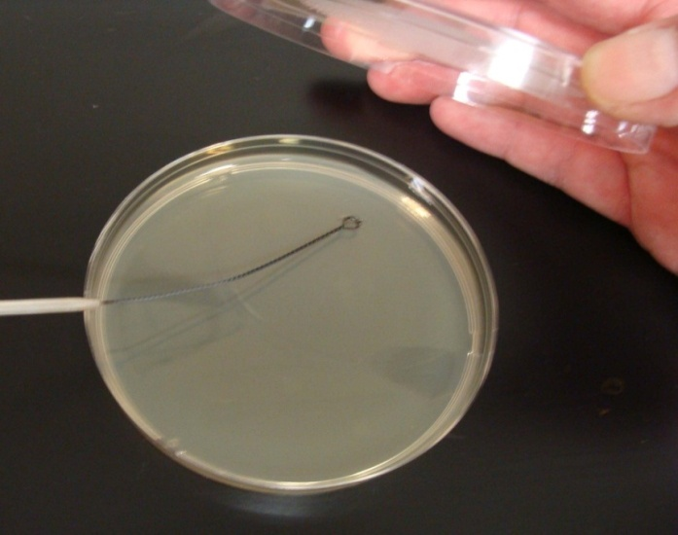
Germ Theory of Disease
Robert koch
Experimented with medium to grow bacteria on.
He tried gelatin, but it did not work.
Wife of colleague recommended agar (a gelatin-like product derived from seaweed).
He could also add various nutrients necessary to grow certain organisms.
Koch (pronounced Coke) originated use of a two part dish for growing bacteria named after Julius Petri, a German bacteriologist), and a technique for isolating pure bacterial colonies.

Slide 12
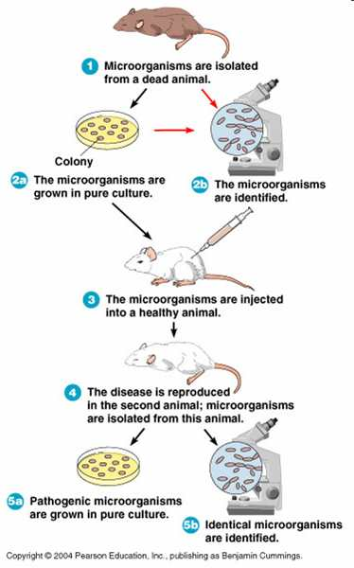
Germ Theory of Disease
Koch’s Postulates

Slide 13
Koch’s Postulates
The organisms should be present in diseased individuals but not in healthy individuals
The organisms must be cultured away from the plant or animal body
Such a culture, when inoculated into susceptible animals, should initiate the characteristic disease symptoms
The organisms should be re-isolated from these experimental animals and cultured again in the laboratory, after which it should still be the same as the original organism.

Slide 14
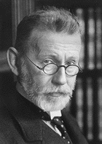
Paul Ehrlich(1854-1915)
Worked in Koch’s Lab doing Differential Staining
Speculated at a Chemical Might Selectively Target Specific Cells and Kill Them.
Developed the Discipline of Chemotherapy and he was father of chemotherapy.

Slide 15
Ernst Ruska

Slide 16
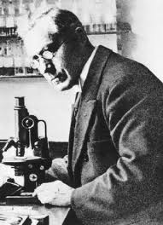
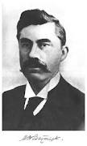
WINOGRADSKY AND BEIJERINCK
Winogradsky founder of soil microbiology
Beijerinck developed concept of the enrichment culture
And rightly called as the founder of virology

Slide 17
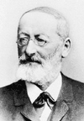
Ferdinand Cohn
Credited with Discovering Endospores
German Botanist

Slide 18
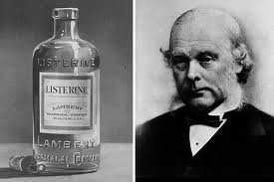
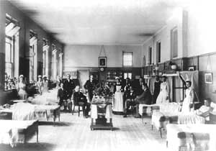
Joseph Lister
Developed Antiseptic Surgery
Sterilized with Heat
Swabbed with Carbonic Acid
Reduced Post Surgical Infections
Lister with his staff at King's College Hospital

Slide 19
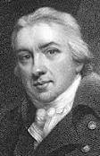
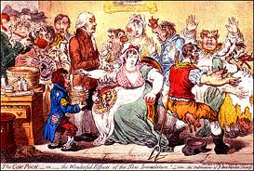
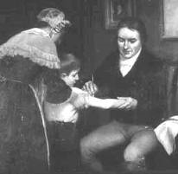
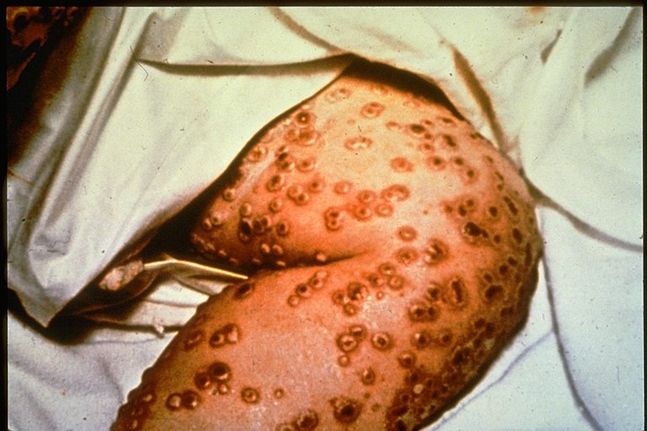
EDWARD JENNER
(1749-1823)
FATHER OF VACCINATION
Smallpox

Slide 20
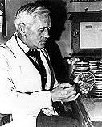
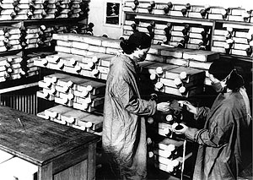
Alexander Fleming (1881-1955)
Early penicillin culture facility at the Sir William Dunn School of Pathology, Oxford, England.
Discovered penicillin
Noted that Mold Might Kill Bacteria

