Slide 1
Biodiversity

Slide 2
What is biodiversity?
OED: “biodiversity Ecol., diversity of plant and animal life, as represented by the number of extant species”
Ricklefs & Miller: Biodiversity includes a number of different levels of variation in the natural world: genetic, species, ecosystem
Begon et al. “The term may be used to describe the number of species, the amount of genetic variation or the number of community types present in an area”.
But…most studies do focus on species diversity

Slide 3
Functional Consequences of Biodiversity:
Numbers and Kinds of Species
Organismal
traits
Ecosystem
Processes
Notes:
Species diversity has functional consequences because the numbers and kinds of species present determine the organismal traits that influence ecosystem processes

Slide 4
Traits and Ecosystem Function
Traits may mediate energy and material flow directly
Traits may alter abiotic conditions (limiting resources, disturbance, microclimate)
Notes:
Species traits with direct effects: lignin decomposers, deep rooting to access water
Alter abiotic conditions: N fixers affect limiting resources, beavers and disturbance, canopies and light levels

Slide 5
Trait Expression Is Determined By:
Species richness
Species evenness
Species composition
Species interaction
Temporal and spatial variation
Notes:
Richness = number of species present
Evenness = relative abundance
Composition = particular species present
Interactions = non-additive affects

Slide 6
The Ecosystem/Ecology Divide
Key ecosystem types in Arctic tundra show clear differences in key species and functional types
But at the ecosystem level there are clear patterns in the landscape irrespective of species composition
Bulk measures like LAI and foliar N are good descriptors of process rates

Slide 7
Species Richness and Ecosystem Function: Theory
If niches are complementary, adding species could increase process rates linearly
As niches overlap the response should saturate
Notes:
Niche – the limits, for all important environmental features, within which individuals of a species can survive, grow and reproduce
Complementary niches would occur if all species contribute substantially and uniquely to a given process
Niches are likely to overlap as diversity increases.

Slide 8
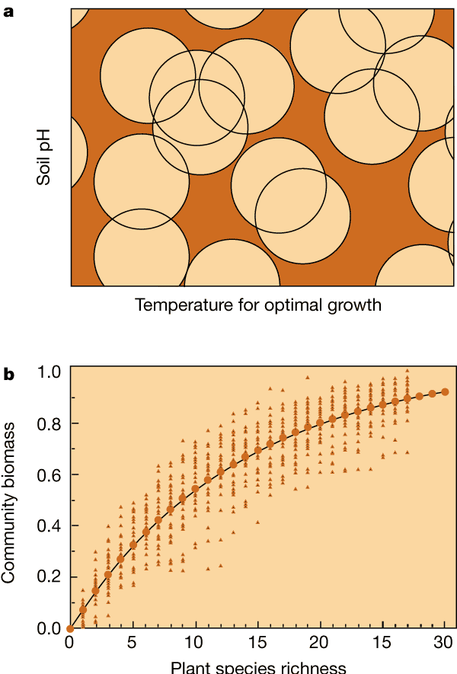
Niche differentiation and productivity. a, A simple model — the 'snowballs on the barn' model — of niche differentiation and coexistence. The range of conditions in which each species can exist is shown with a circle, the position of which is defined by its centre. By randomly choosing locations for various numbers of circles (species), it is possible to calculate the effect of diversity on the 'coverage' of the heterogeneous habitat. The amount of such coverage is proportional to community biomass. b, Results of simulations (triangles) and of an analytical solution (solid curve) to the effects of diversity on community productivity for the snowballs on the barn model

Slide 9
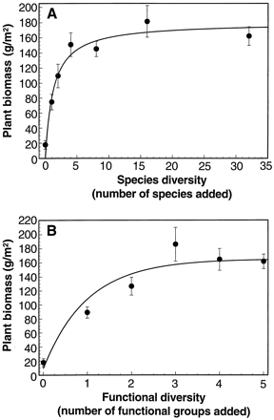
Dependence of 1996 aboveground plant biomass (that is, productivity) (mean and SE) on the number of plant species seeded into the 289 plots.
Dependence of 1996 above-ground plant biomass on the number of functional groups seeded into each plot. Curves shown are simple asymptotic functions fitted to treatment means. More complex curves did not provide significantly better fits
From: Tilman et al. (1997) Science

Slide 10
Problems With Richness Experiments
Disentangling interactions in natural systems is difficult
Measuring productivity (below ground)
Scale (too short and too small)
‘Sampling effect’ problem in constructed communities
Sampling effect may be an important biological property or an experimental artefact if natural community assembly rules are broken

Slide 11
Species Interactions
Mutualism
Trophic interaction
Predation
Parasitism
Herbivory
Competition
Notes:
Most ecosystem processes are non-additive functions of the traits of two or more species
Interactions among species, rather than the simple presence or absence of species, determine ecosystem characteristics

Slide 12
Mutualism
N-fixation in plant-microbe symbiosis
Plant-mycorrhizal associations
Both increase production and accelerate succession
Decomposition is driven by highly integrated consortia of microbes

Slide 13
Biodiversity and Ecosystem Services
Ecosystem services are defined as the processes and conditions of natural ecosystems that support human activity and sustain human life
E.g., maintenance of soil fertility, climate regulation, natural pest control
E.g., flows of ecosystem goods such as food, timber and freshwater

Slide 14
Thank you

