Slide 1
A.S.D.GOVERNMENT DEGREE COLLEGE FOR WOMEN (AUTONOMOUS) KAKINADA
DEPARTMENT OF MICROBIOLOGY
Labelled Antibody Techniques
II BSc CBMB SEM IV
BY
Dr. K. Aruna
Lecturer in Microbiology

Slide 2
Introduction
Antibody labeling:
Attachment of a specific tag to an antibody to aid in detection or isolation/purification of a protein, is an important technique.
Labeled antibodies are essential for immuno-based assays such as Western blots, ELISAs, immuno fluorescence (IF), flow cytometry and immunohistochemistry (IHC).
Molecules (lables)such as dyes or enzymes are conjugated (attached) to the Fc portion of the antibody.
These labels has a ability to bind to antigen
The first sensitive and reliable drug and hormone assay used antibodies labelled with radioisotope, called radioimmunoassay(RIA),
Immunofluorescence and ELISA

Slide 3
Fluorescent –antibody Technique(Immunofluorescence)
Fluorescence is the property of certain molecules to absorb light at one wave length and emit at longer eave length when it is illuminated by light of a different wavelength
It is used to identify the unknown antigen
Fluorescenin isothiocynate and rhodamine isothiocyanate
This technique may be direct or Indirect
Direct Method:
Labelled antibodies are treated with antigen and observed under fluorescent microscope.
Only dye labelled antibodies attaches antigen or microorganisms become visible .
Indirect Method:
The initially applied antibody is not labelled with the dye , second labelled antibody is applied which binds to unlabelled antibody –antigen .

Slide 4
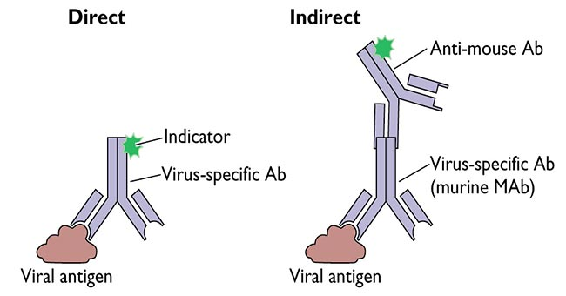
Immunofluorescence

Slide 5
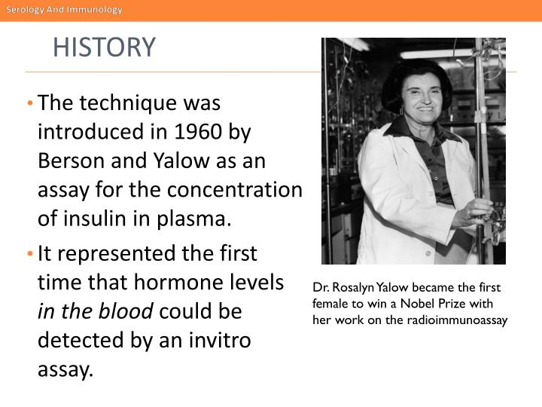
Radioimmunoassay (RIA)
Radioimmunoassay (RIA) quantifies the amount of specific antigens in patient serum.
This technique uses antigens labelled with radioisotopes, usually ¹²⁵I
Principle: Competitive binding between labelled antigen and unlabelled antigen to a high affinity antibody
This technique was introduced in 1960 by Berson and Yalow as an assay for the concentration of insulin in Plasma

Slide 6
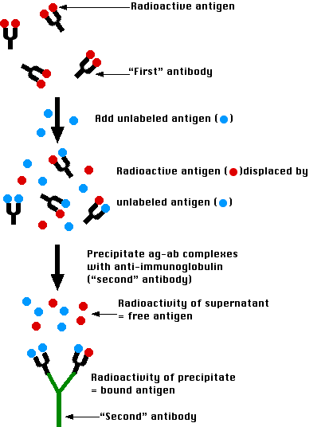
Radioimmunoassay (RIA)

Slide 7
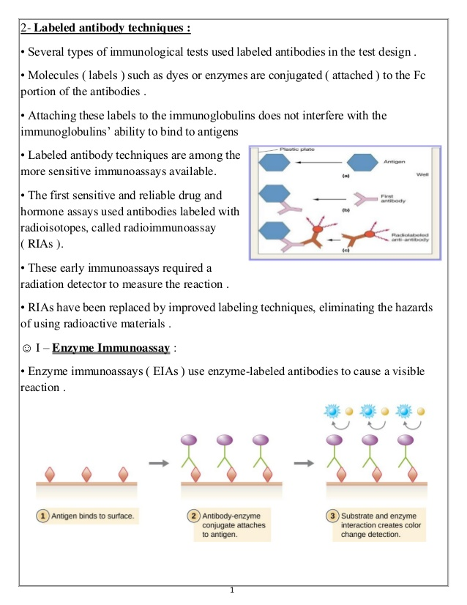
ELISA
Enzyme Linked Immunosorbent Assay(ELISA)
It is very sensitive, immunological technique used to access the presence and quantification of specific (antigen ro antibody ) in the given sample
An enzyme conjugated with an antibody reacts with colorless substrate to generate a colored reaction product
No of Enzymes are used in ELISA are Alkaline Phosphatase and Horseradish Peroxidase
The enzyme activity may be monitored directly by measuring the product formed

Slide 8
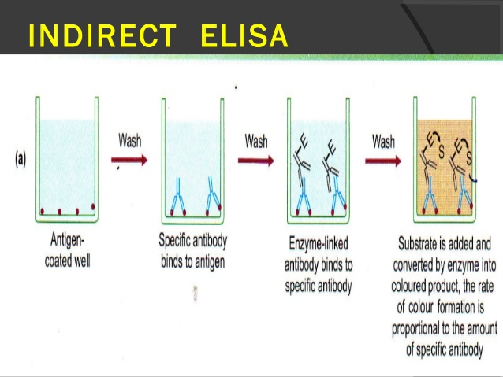
Indirect ELISA
A number of variations of ELISA have been developed, allowing qualitative detection or quantitative measurement of either antigen or antibody
Indirect ELISA
It detects the presence of antibody in the sample
The wells of Micro-ELISA plates are first fill with antigen which adsorb to the well surface
Test antiserum is added to the wells and allow to incubate , if the antibody is homologous, they bind with adsorbing antigen
Then wash and remove the free antibodies
Labelled Antibodies are added which link to the Ag-Ab complex
After incubation wash the plate
A substrate for enzyme is added
A coloured product is measured by spectrophotometer
Intensity of the colour is directly proportional to the enzyme-linked antibody, which in turn, is proportional to the amount of antibody present in the test anti-serum.

Slide 9
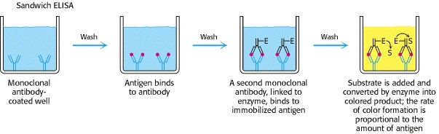
Direct or Sandwich ELISA
It is used to identify antigen
The wells of micro-ELISA plates filled with antiserum, the antibodies present in the antiserum adhere to the surface of the each well
Then incubated and washed
The test-antigen is added and binds to the antibody if it is homologous, It forms Ag-Ab complex
Then incubated and washed
Enzyme –conjugated antibody added that binds to antigen-antibody complex
Washed off the unbounded antibody –enzyme conjugates
The Substrate for enzyme ids added
Colour change can be measured by spectrophotometer

Slide 10


