Slide 1
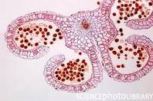
MICROSPOROGENESIS

Slide 2
MICROSPOROGENESIS---FORMATION OF MICROSPORES/POLLEN GRAIN

Slide 3
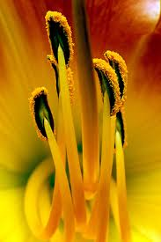
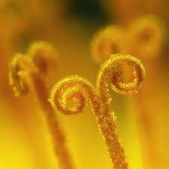
MALE REPRODUCTIVE UNIT .STAMEN
It consists of two parts long and slender stalk called filament and bilobed structure called anther.

Slide 4
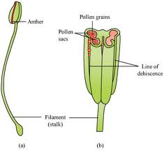
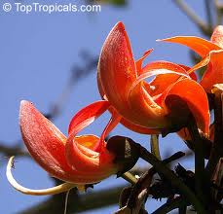
STRUCTURE OF ANTHER
The anther is bilobed and each lobe consists of two microsporangia separated by septum In cross section it consists of four microsporangia which transforms into pollen sacs.

Slide 5

STRUCTURE OF MICROSPORANGIUM
-Microsporangium has a wall and sporogenous tissue inside.
The wall is divided into epidermis endothecium middle layer and tapetum.
The outer three layer is protective in nature and tapetum provides nourishment to the developing pollen grain.
The inner portion of the cell is filled with sporogenous cells.

Slide 6
MICROSPOROGENESIS
The process of formation of microspore from PMC through meiosis is called microsporogenesis.
The sporogenous cells divide meiotically to form microspore tetrads.In this process haploid microspore are formed.
It occurs inside the microsporangia or pollen sac of anther.
The four microspore formed from MMCare arranged in tetrad and are functional.
The microspore gives rise to male gametophyte.

Slide 7
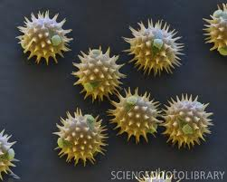
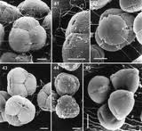
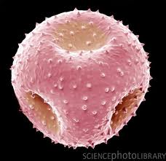

Slide 8
POLLEN GRAIN
Pollen grain represent male gametophyte.
They possess two layered wall.
The outer wall is called exine and inner wall is called intine.
The exine is composed of sporopollenin.
The intine is composed of cellulose and pectin.

Slide 9
Thank You

