Slide 1
STRUCTURE AND FUNCTION OF CHROMOSOMES
G.Swapna
Lecturer in Botany

Slide 2
DEFINITION OF CHROMOSOME
It is a combination of two words, i.e., “Chroma”-means ‘colour’ and “Somes”-means ‘body’.
So the coloured thread like bodies present in the nucleoplasm of the living cells, which helps in the inheritance (transmission) of characters in form of Genes from generation to generation are known as CHROMOSOMES.

Slide 3
NUMBER OF CHROMOSOMES
The number of chromosomes per organism is always a definite number, Which is said as Diploid (2n) no., but gametes, sperms, ova etc. carry Haploid (n) number. Some examples are given below.
Name of the Diploid No. Name of the Diploid No.
organism (2n) organism (2n)
Human beings ---- 46 Onions ----- 16
Cat ---- 38 Corn ----- 20

Slide 4
PHYSICAL STRUCTURE
Size varies from 1 to 30 micron in length and diameter from 0.2 to 2 micron.
CENTROMERE:- The non-stainable part of the chromosome making a primary constriction.
CHROMATIDS:- Two chromatids join at the centromere to form a chromosome.
CHROMONEMA:- In each chromatid, there are two longitudinal chromonemata coiled with each other.
CHROMOMERES:- In each chromonemata, there are “bead” like chromomeres present through out the coil.
GENES:- Each chromomeres contains genes, the unit of inheritance of character.
SATELLITE:- In some chromosomes a round and elongated satellite is present.
CONSTRICTION:- Presence of centromere shows the primary constriction. But in some cases there is an additional Secondary Constriction.
SURFACE VIEW

Slide 5
TYPES OF CHROMOSOMES
TELOCENTRIC:- The centromere is
present at the end of the chromosomes.
CENTROMERE
LONG ARM
SHORT ARM
CENTROMERE
2. ACROCENTRIC:-The centromere is almost terminal. It has one large and another very small arm.
LONG ARM

Slide 6
TYPES OF CHROMOSOMES
(CONTINUED)
SHORT ARM
3. SUB-METACENTRIC:- Here the centromere is not at the middle position of the chromosomes. So the arms are unequal and it is ‘L-Shaped’ in appearance.
CENTROMERE
LONG ARM
TWO EQUAL ARMS
4. METECENTRIC:- The centromere is at the middle position. So the arms are equal and it is ‘V-Shaped’ in appearance.
CENTROMERE

Slide 7
CHEMICAL STRUCTURE
Chemically the chromosomes are made of proteins and nucleic acids.
PROTEINS It is mainly Protamines, Histones and smaller amount of acidic proteins.
NUCLEIC ACIDS It is de-oxy ribose Nucleic Acids (DNA). Genes are nothing but the segments of DNA.
NB:- For brief notes about DNA structure, “Open the Hyperlink at Right End.”
CLICK
HYPERLINK

Slide 8
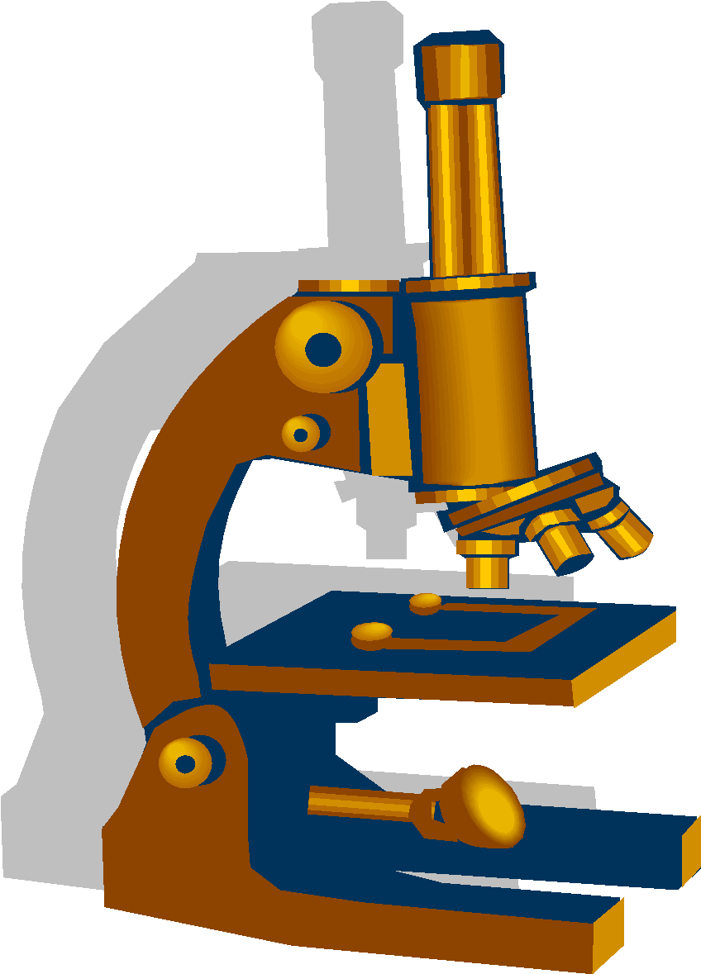
FUNCTION OF CHROMOSOMES
FUNCTION OF CHROMOSOMES
[I]- The chromosomes are capable of self-duplication. During duplication process the DNA strands unwind. As unwinding starts, each template of DNA forms its complementary strand in double-helix nature. The conversion of the old DNA molecule into two new molecules, helps in duplicating the chromosomes.

Slide 9
SELF DUPLICATION OF DNA MOLECULE
(IT HELPS IN THE DUPLICATION OFCHROMOSOMES )
Single DNA molecule in double helical structure
Mother templates unwind and new complementary strands originate
Unwinding continues along with new template formation
Two separate DNA molecules formed having an old and a new strand

Slide 10
Function of chromosomes (continued)…
[II]- They help in expression of different characters in an organism by synthesizing proteins in cells. A definite protein is accumulated to produce a definite character.

Slide 11

Function of chromosomes (continued)…
[III]- As carrier of genes they transmit characters from generation to generation , i.e. parents to offspring.
[IV]- The chromosomes control the physiological and biochemical processes in the body of the organism.

Slide 12
Thank You

